Slide 1
Manchester
Raspberry Jam 26
February 2015

Slide 2
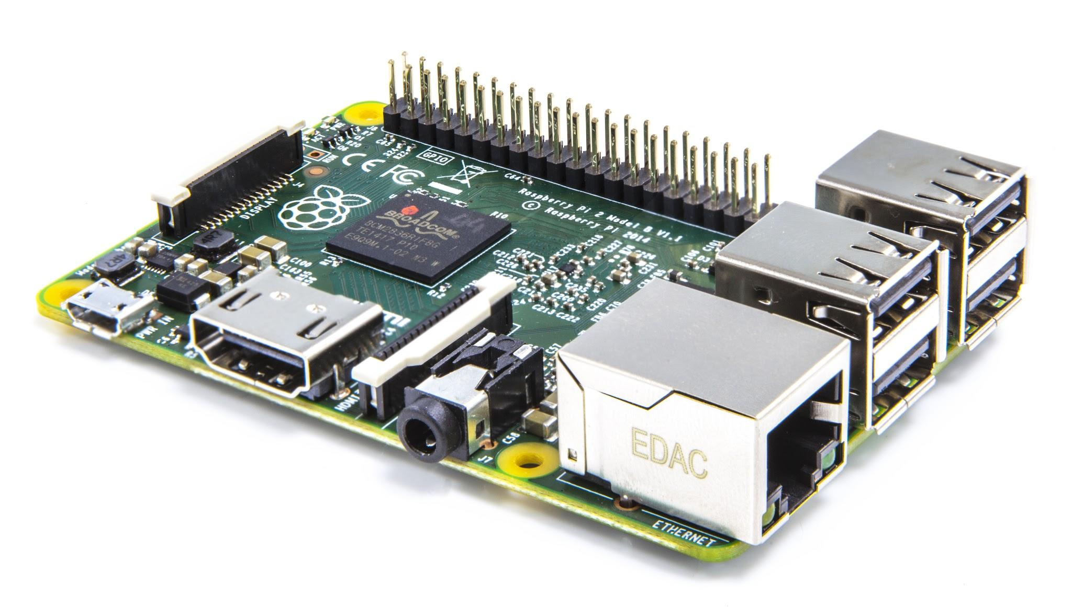
Raspberry Pi 2

Slide 3
For Today
11:30am - GPIO with Scratch workshop
1:00pm - Pizza!
All day - “Bullet Time” camera rig

Slide 4
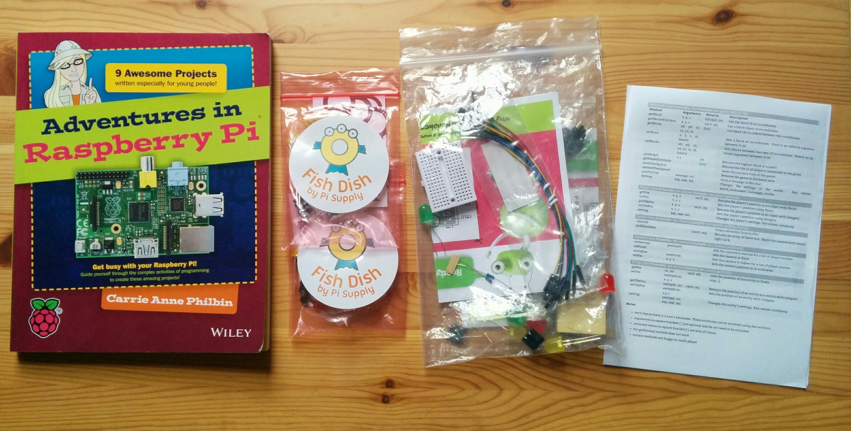
Stuck for ideas?
http://www.raspberrypi.org/introducing-raspberry-pi-model-b-plus/

Slide 5
Next Month...
Manchester Raspberry Jam 27
Saturday 7th March

Slide 6
Next Month...
Manchester Raspberry Jam 26
Saturday 7th February

